Slide 1
Dry Erase Board Robot - DrawGüd
Ben McDermott, Ronan Gissler, and Taylor Korte
Notes:
Taylor?

Slide 2

THE DESIGN
2 Linkages
1 Expo marker clamp
2 Small servos (elbow and wrist)
1 Big servo (shoulder)
1 Dry erase board mount with embedded magnet
3 Roller Bearings
Notes:
Taylor?

Slide 3
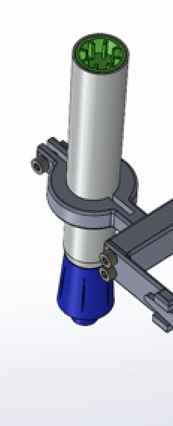
DEMO AND DESIGN DECISIONS
Included wrist joint to lift marker off of board
Using small servos to reduce weight
Detachable servo grips for easy assembly
Roller bearings embedded into the arms for smooth rotation
Notes:
Ronan? - talk about clamp design for servos

Slide 4
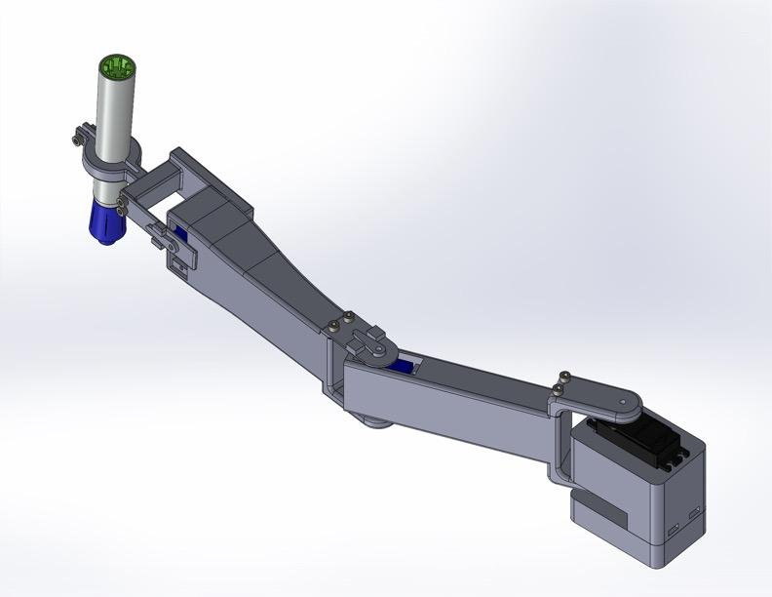
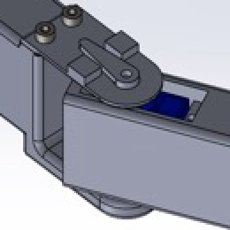
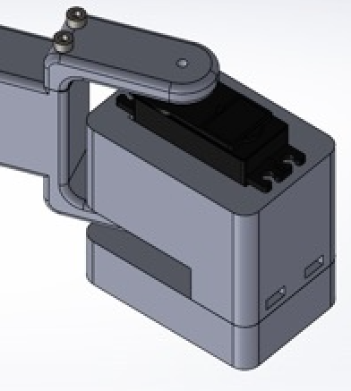
NEXT STEPS
Create a mapping of letters
Use these mappings to find desired x,y coordinates of arm
Use inverse kinematics to translate these x,y coordinates into theta values for the servos
Wrist
65 mm
Elbow
137 mm
Shoulder
130 mm
Material: PLA
Notes:
Ben

Slide 5
​​Thanks!
Questions?
Notes:
Ben

